Slide 1
US Consumer eCommerce Shopify Implementation
How to Execute the User Testing for Brand Site(PreserVision)
April 3rd, 2023

Slide 2
Points Covered
1
Steps to follow
2
Create Local copy of Testing file
3
Rename the File
4
User Testing
5
Record Observations
6
Go through test scenarios
7
Save to folder

Slide 3
Steps to follow
1. Create Local copy of Testing file
2. Rename the File
3. User Testing
4. Record Observations
5. Go through test scenarios
6. Save file to folder

Slide 4
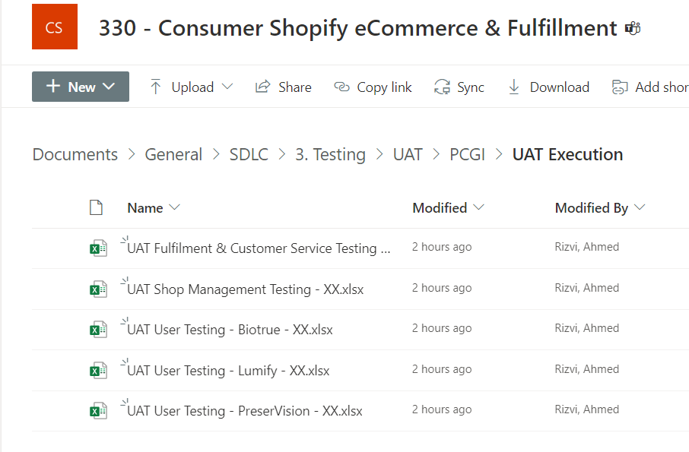
Create Local copy of Testing file
Click here to go to 330 - Consumer Shopify eCommerce & Fulfillment - UAT Execution - All Documents (sharepoint.com)
Select the UAT file as per your Brand name for which you will be executing the User Testing.
E.g.: If you are testing for PreserVision, then copy the "UAT User Testing - PreserVision - XX.xlsx" file to your local machine.
Make a local copy of the same.
Create local copy of testing file as per brand. (e.g. PreserVision)

Slide 5
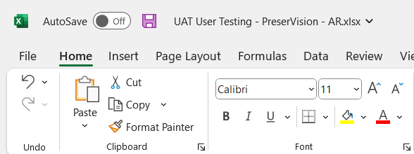
Rename The File
After making local copy rename the file.
Replace “XX” with your initials in the file name.
E.g.: If you name is “Ankita Jadhav”, then replace “XX” with “AJ”
Old name- UAT User Testing - PreserVision - XX.xlsx
New Name- UAT User Testing - PreserVision - AJ.xlsx
Renaming the File

Slide 6
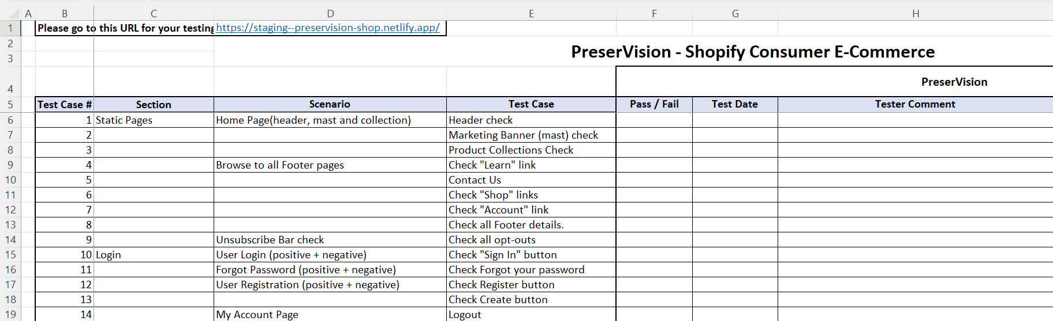
User Testing
Each file has the brand URL written on the top that you have to click to open the Staging site where you will carry out the User Testing
Each file has different columns and set of columns have different User Testing Scenarios mentioned in the column C (Heading - Section) and Column D (Heading Scenario)
Staging URL for testing
Column headers with testing scenarios

Slide 7
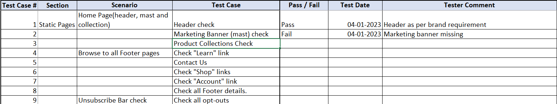
Record observations
Column D (Heading - Test Case) lists down the steps that you would like to check/test and record your observations, if any.
As per your observations in regards of column D, select "Pass“/ “Fail” from the dropdown in the column F (Heading - Pass / Fail)
Add testing date as (MM/DD/YYYY) and tester comment if any as shown in image.
Note- Observations in image are only for education purpose and not actual results
Recording the observations as “Pass/Fail” with date and comment if any.

Slide 8
Go Through Test Scenarios
Go through as many test scenarios as possible.
Select correct option in column F (Heading- “Pass”/ “Fail”)
Record date of testing in format (MM/DD/YYYY)
Mention comment in case of “Fail” case.
Mention comment in case of “Pass” if necessary.

Slide 9
Save file to folder
Re-check the file is saved as per requirements mentioned in slide “Rename the file” (Slide #4).
E.g.: UAT User Testing - PreserVision - AJ.xlsx
Upload the updated testing file to 330 - Consumer Shopify eCommerce & Fulfillment - UAT Execution - All Documents (sharepoint.com)
Notify Robert that you have finished your testing.

Slide 10
Thank You

